Slide 1
Probability and Odds Using Skittles
By Malaina Hynes

Slide 2
Goals
Clarify the difference between probability and odds
Make predictions based on our data
Calculate different probability fractions
Calculate different ratios in relation to odds
Have fun!

Slide 3
Review!
Example: When a single dice is thrown, what is the probability that it will land on the number 4?
What is probability?
Probability is defined as “the likelihood that an event will occur”.
Answer: 1/6
The answer is 1/6 because there is 1 out of the 6 sides of the dice that has a 4 on it.

Slide 4
Review!
What is odds?
Odds is defined as a ratio of the number of ways something can occur to the number of ways it cannot occur.
Example: When a single dice is thrown, what are the odds that it will land on the number 4?
Answer: 1 : 5
The answer is 1 to 5 because there is 1 side that has a 4 and 5 sides that do not have a 4.

Slide 5
Remember!
Probability →
Chances it will happen
Total number of chances
Odds →
Chances for to Chances against
For : Against

Slide 6
Let’s Start!

Slide 7
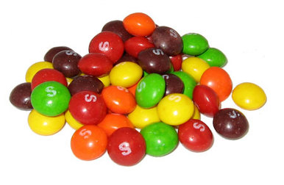
Step 1:
Open Skittles and Calculate Total

Slide 8
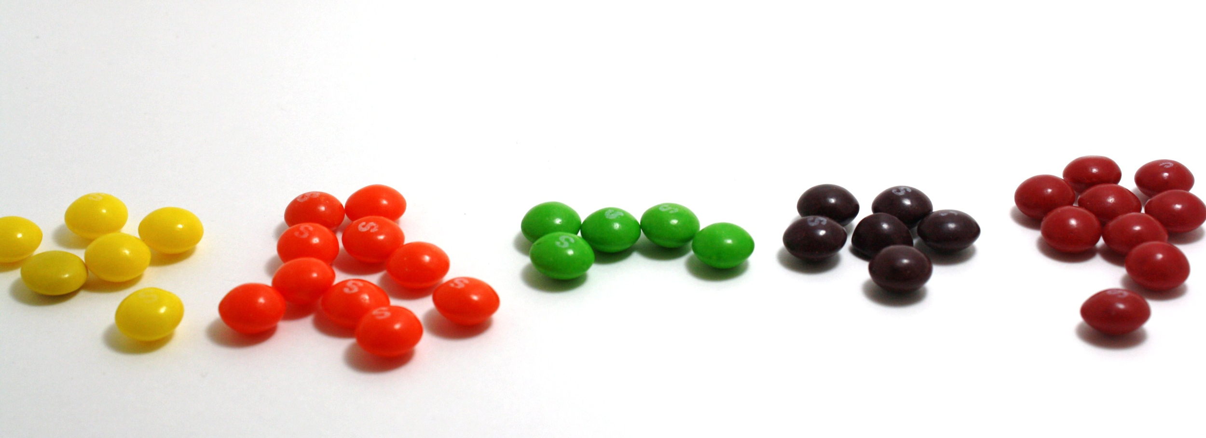
Step 2:
Sort Skittles by color

Slide 9
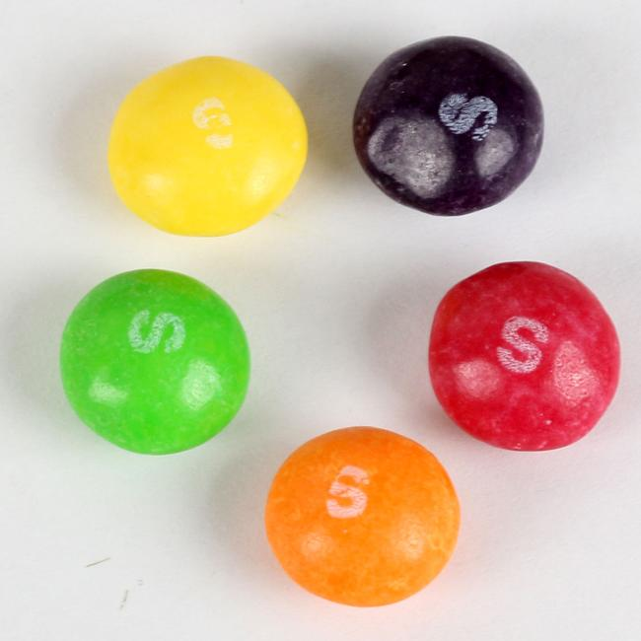
Step 3:
Calculate the separate totals for each color

Slide 10
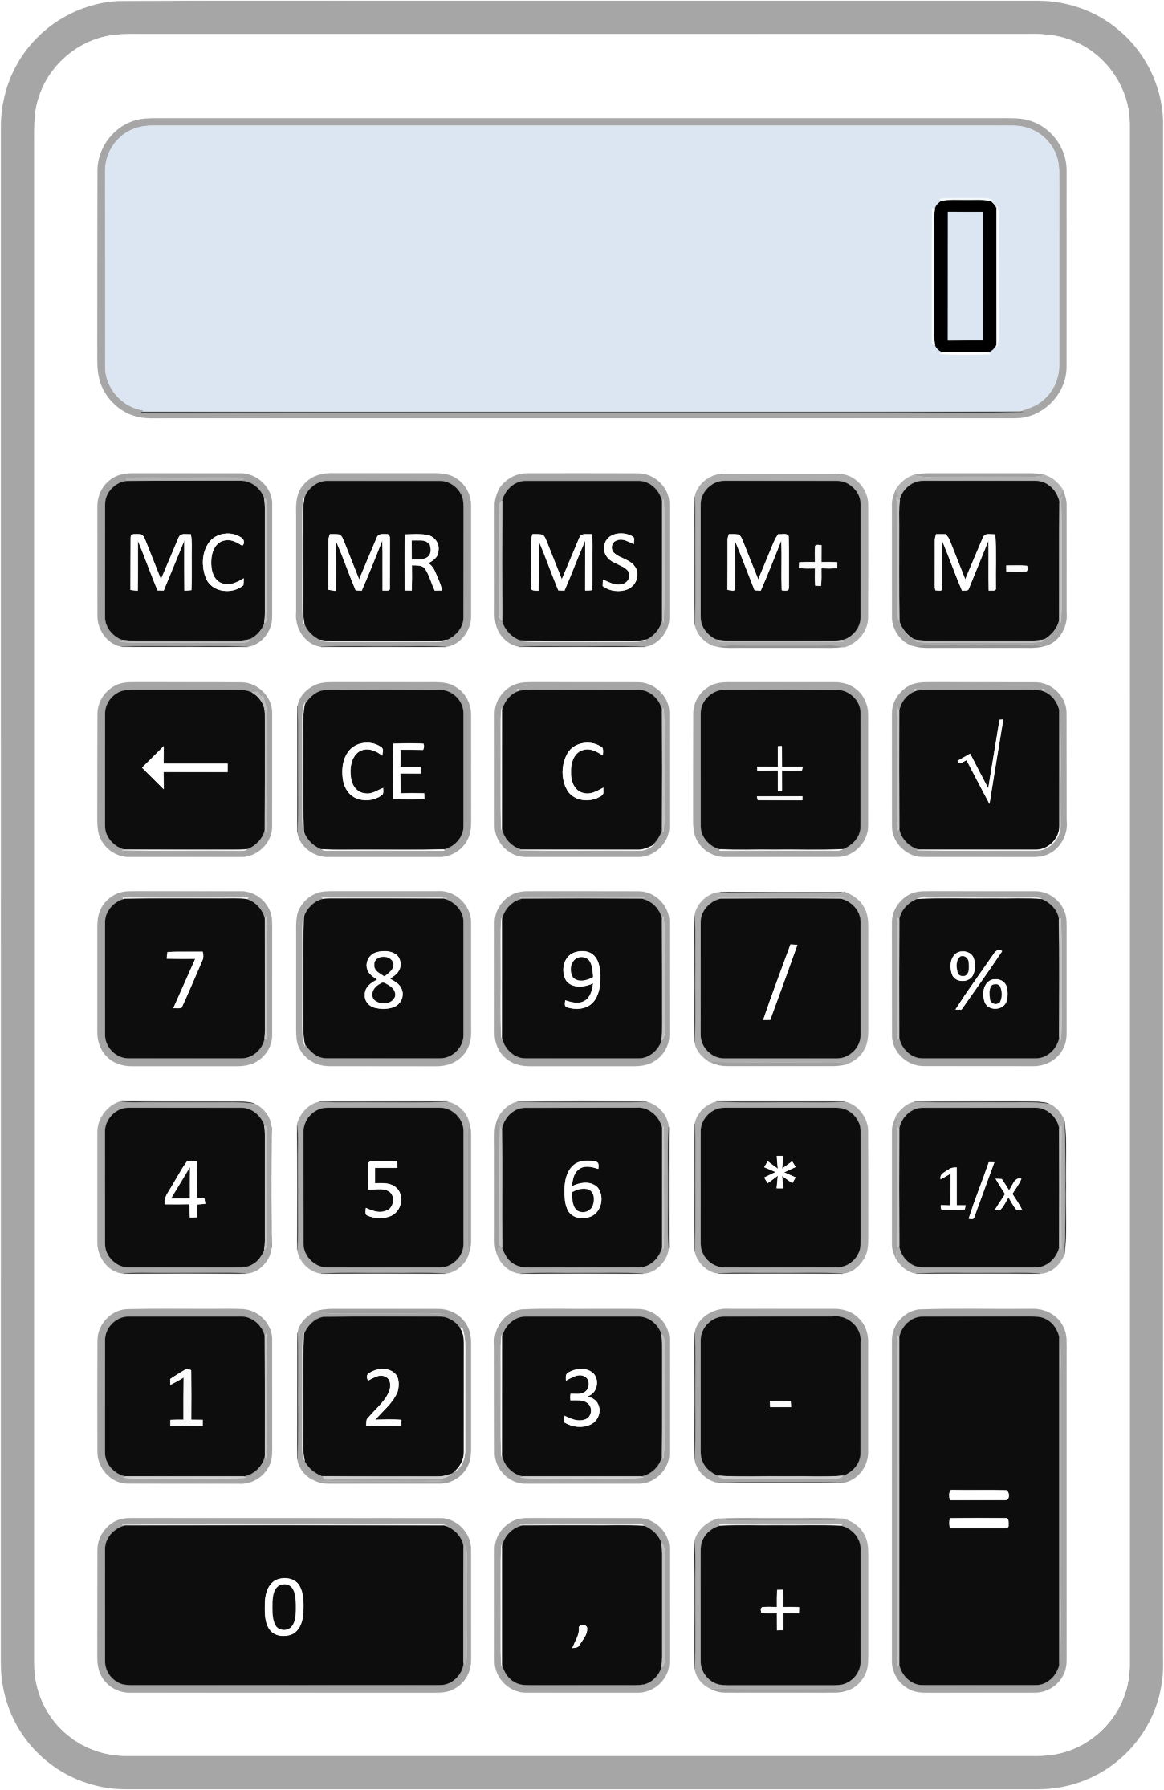
Step 4:
Calculate the
probability of
getting each
color.

Slide 11
Step 5:
Calculate the
odds of
getting each
color.

Slide 12
Step 6:
Answer the questions related to probability and odds.

Slide 13
What conclusions can you draw about probability and odds?

Slide 14
Wrap Up!
What is probability?
What is odds?
What is the difference between probability and odds?
Is there one assumption that we can make based on the class’ data as a whole?
Is finding the probability of an event more accurate than finding the odds of an event?

Slide 15
References
Definition of Odds. (2017). Mathsisfun.com. Retrieved 27 April 2017, from https://www.mathsisfun.com/definitions/odds.html
Definition of Probability. (2017). Mathsisfun.com. Retrieved 27 April 2017, from https://www.mathsisfun.com/definitions/probability.html
Milleson, K. (2012). Probability and Odds - Skittles Activity. Ms. Milleson's 7th Grade Blog. Retrieved from http://msmilleson32.blogspot.com/2012/03/probability-and-odds-skittles-activity.html

